Slide 1

Solution Architecture Training Notes
By Aung Kyaw Minn
This document is licensed under the Creative Commons Attribution-NonCommercial 4.0 International License (CC BY-NC 4.0)

Slide 2
License Information
This work by Aung Kyaw Minn is licensed under a Creative Commons Attribution-NonCommercial 4.0 International License (CC BY-NC 4.0). You are free to:
Share: copy and redistribute the material in any medium or format
Adapt: remix, transform, and build upon the material
Under the following terms:
Attribution: You must give appropriate credit, provide a link to the license, and indicate if changes were made. You may do so in any reasonable manner, but not in any way that suggests the licensor endorses you or your use.
NonCommercial: You may not use the material for commercial purposes.
To view a copy of this license, visit Creative Commons BY-NC 4.0 License.

Slide 3
Preface
The information presented in this document is a compilation of:
Experience: Insights and lessons learned from previous projects.
Knowledge: Understanding acquired through trainings, experiments, and interactions with professionals.
Skill: Practical skills having been refined through hands-on practice and application.
Aung Kyaw Minn

Slide 4
Goal & Objectives
The primary goal of this training is to equip experienced engineers with the knowledge and skills required to transition into the role of a Solution Architect.
This training will cover essential concepts, methodologies, and best practices in solution architecture, enabling participants to design robust, scalable, and efficient systems that align with business goals and technical requirements.

Slide 5
Expected Outcomes
By the end of the training, participants will be able to:
Understand the core principles of solution architecture.
Design end-to-end solutions that address complex business problems.
Evaluate and select appropriate technologies and frameworks.
Create architectural blueprints and documentation.
Ensure solutions are scalable, secure, and maintainable.
Collaborate effectively with stakeholders, including business leaders, developers, and other architects.

Slide 6
List of Contents
Architecture Domains
Software Delivery
Solution Architecture
Architecture
Solution
Making Technical Decision
Data Modeling
API Fundamental

Slide 7
Architecture Domains
Basic Concepts

Slide 8
BDAT
Business
Data
Application
Technology

Slide 9
Business Domain
Considerations, Roles and Responsibilities

Slide 10
Considerations
Business Requirements
Start by understanding what the business needs from the software, defining the problem it's supposed to solve, and how it aligns with the business strategy.
Business Processes
Identifying and analyzing the business processes that will be impacted or improved by the software.
Stakeholders
Ensuring that the views and needs of all stakeholders are considered during the software development process.
Notes:
Understanding Requirements: You start by understanding what the business needs from the software, defining the problem it's supposed to solve, and how it aligns with the business strategy.
Business Processes: Identifying and analyzing the business processes that will be impacted or improved by the software.
Stakeholder Engagement: Ensuring that the views and needs of all stakeholders are considered during the software development process.

Slide 11
Roles
Business Analysts
Business Architects
Product Managers
Product Owners
Notes:
Business Analysts: They gather, analyze, and document business requirements and ensure that the solutions meet these requirements.
Business Architects: They align the strategic objectives and tactical demands by designing business processes, capabilities, and governance structures.
Product Managers: They define the product vision and roadmap, acting as a bridge between the business and development teams.
Process Owners: They are responsible for the end-to-end management of business processes and for driving process improvements.

Slide 12
Responsibilities
Defining business strategy and goals.
Mapping out business processes and capabilities.
Communicating requirements to technical teams.
Ensuring that IT solutions align with business objectives.

Slide 13
Deliverables
Business Strategy Documents
Outlines the goals, objectives and tactics of the organization.
Business Process Models
Visual representation of the business processes, often created using BPMN (Business Process Model and Notation).
Value Stream Maps
Identify the value-adding steps in business processes to enhance efficiency and effectiveness.
Capability Maps
Depict the core capabilities of the business and maturity of these capabilities.

Slide 14
Data Domain
Considerations, Roles and Responsibilities

Slide 15
Considerations
Data Modeling
Designing the data structures that will be used by the software, ensuring that the data model supports the business processes.
Data Management
Considering how data will be captured, stored, retrieved, archived, and deleted by the software.
Data Security and Privacy
Applying policies and mechanisms to protect data security and privacy, which is especially important if you handle sensitive or personal information.
Notes:
Data Modeling: Designing the data structures that will be used by the software, ensuring that the data model supports the business processes.
Data Management: Considering how data will be captured, stored, retrieved, archived, and deleted by the software.
Data Security and Privacy: Applying policies and mechanisms to protect data security and privacy, which is especially important if you handle sensitive or personal information.

Slide 16
Roles
Data Architects
Data Analysts
Database Administrators
Notes:
Data Architects: They define how data is structured, stored, managed, and used across the organization.
Database Administrators (DBAs): They manage and maintain database systems to ensure their availability and performance.
Data Analysts/Scientists: They analyze data to support decision-making and may develop algorithms or statistical models.
Data Governance Specialists: They are involved in setting data standards and policies.

Slide 17
Responsibilities
Developing data models and database designs.
Implementing data quality and data governance processes.
Managing data security, compliance, and privacy.
Supporting data analytics and business intelligence efforts.

Slide 18
Deliverables
Data Models
Include conceptual, logical and physical data models.
Data Dictionary
A catalog of all data elements, detailing attributes like data type, source, usage and ownership.
Data Flow Diagrams
Visualize the flow of data through the system, showing how data is processed and stored.
Master Data Management Strategy
Define how key enterprise data (like customer or product information) is managed across the organization

Slide 19
Application Domain
Considerations, Roles and Responsibilities

Slide 20
Considerations
Application Architecture and Design
Deciding on the architecture of the software, including how it will be broken down into components, services, or microservices.
Development Tech-Stack and Frameworks
Choosing the right frameworks, programming languages, and tools that will be used to build the software.
User Experience
Ensuring that the application is user-friendly and meets the end-users' requirements.
Notes:
Architecture and Design: Deciding on the architecture of the software, including how it will be broken down into components, services, or microservices.
Development Frameworks: Choosing the right frameworks, programming languages, and tools that will be used to build the software.
User Experience: Ensuring that the application is user-friendly and meets the end-users' requirements.

Slide 21
Roles
Application Architects
UI/UX Designers
QA Engineers
Software Development Team Leads
Notes:
Application Architects: They are responsible for the high-level design of the software applications.
Software Developers/Engineers: They develop the application by writing code and translating design into functioning software.
User Experience (UX) Designers: They focus on the design of user interfaces and user interactions with the application.
Quality Assurance (QA) Analysts: They ensure the application meets quality standards and functions as intended.

Slide 22
Responsibilities
Designing the architecture of the application.
Ensuring application scalability, reliability, and security.

Slide 23
Deliverables
Software Architecture Documents
System Design Diagrams
Detailed Descriptions
Quality Attribute Requirements
Technology Choices
Risk Analysis
Data Integration and Management Strategies

Slide 24
Technology Domain
Considerations, Roles and Responsibilities

Slide 25
Considerations
Development
Development environment setup, actual coding, and integrations
Deployment
Planning how the software will be deployed, updated, and maintained.
Determining what kind of infrastructure is needed to support the software, whether it's on-premises servers, cloud-based services, or a hybrid approach.
Performance and Scalability
Ensuring that the technological solutions chosen can handle the expected load and can scale as the number of users or the volume of data grows.
Notes:
Infrastructure: Determining what kind of infrastructure is needed to support the software, whether it's on-premises servers, cloud-based services, or a hybrid approach.
Deployment: Planning how the software will be deployed, updated, and maintained.
Performance and Scalability: Ensuring that the technological solutions chosen can handle the expected load and can scale as the number of users or the volume of data grows.

Slide 26
Roles
Software Engineers/Developers
SREs
DevOps Engineers
Network Engineers
Cloud Specialists
Security Architects
System Administrators
Notes:
Technology/Infrastructure Architects: They design and guide the implementation of technology solutions, such as networks and hardware infrastructures.
System Administrators: They manage and configure hardware and software systems.
Network Engineers: They design and manage network infrastructure to ensure connectivity and performance.
Cloud Specialists: They focus on cloud services and infrastructure, such as deployment and management in cloud environments.
Security Architects: They design and implement the organization's security framework to protect against threats.

Slide 27
Responsibilities
Designing the technology infrastructure to support business operations.
Ensuring IT systems are scalable, secure, and resilient.
Managing the deployment and ongoing maintenance of technology systems.
Ensuring compliance with IT policies and standards.

Slide 28
Deliverables
Application/Software
Infrastructure Diagrams
Show the physical and logical layout of IT infrastructure, including servers, network devices, and storage systems.
Technology Standard Documents
Outline the approved technologies, platforms, and tools for use within the organization.

Slide 29
Software Delivery
From building the software to deploying it into a production environment, where it becomes operational for end-users

Slide 30


Domains and Process
Vendor Management
Business
Client’s Business Requirements
Data
Data Modelling
Application
Architecture,
Technology
Development,
Deployment
System Design,
Infrastructure,
UI/UX Design
Vendor
Client
PM/Lead
Software Delivery

Slide 31
Domains and Roles
Business
Data
Application
Technology
Client
Business Analyst
Solution Architect
System Analyst
Software Engineer
Site Reliability Engineer

Slide 32
Workflow and SDLC
Plan
Analyze
Design
Code
Deploy, Test
Business/System Flow,
UI Wireframe
Development Plan
Project Manager
Business Analyst
Development
Team Lead
Software Engineers
SRE
Product Owner /
Client’s Representative
Designer
QA Engineers
Product backlog /
Requirements
UI/UX
Solution Architect

Slide 33
Software Development Activities
# | Activity | Role | Output | Document Tools
1 | Requirement Analysis | BA | Diagrams, Wireframe, BRS | whimsical, Word
2 | Conceptual Data Modeling | SA | ER Diagram | drawio
3 | UI Design & Prototyping | Designer | Design Mockup, Prototype | Figma
4 | Logical & Physical Dat Modeling | SA | DB Schema | dbdiagram / dbdocs
5 | System Design | SA | System design artifacts | drawio
6 | Prototype Usability Testing | BA, QA | Prototype, Test Plan/Case | Figma
7 | API Definition | SA / Lead | API Documentation | Postman
8 | Coding | SE | Software | Scribe / Swagger UI
9 | Testing & Creating User Manual | QA | Issues, User Guide Docs | Excel, Clickup

Slide 34
Development Process Order of activities might be adjusted according to the situation. That’s about your Wisdom. How wise are you?
1. Requirement Analysis
2. Conceptual Data Modeling
3. UI Design & Prototyping
4. Logical and Physical Data Modeling
5. System Design
6. Prototype Usability Testing
7. API Definition
8. Coding
9. Testing

Slide 35
Solution Architect
Serves as a bridge between business and technology domains, ensuring that technology solutions align with business goals and requirements.

Slide 36
What’re the works
Business
Data
Application
Technology
Architecture
Solution

Slide 37
Business Domain – CRPM
Context
Environment and Stakeholders
Requirements
Key requirements and goals
Processes
Outline of relevant business processes
Models
How the business deliver value to customer and revenue is generated
Notes:
Business Domain
Business Context
E-ComMax is an online retail platform designed to facilitate the buying and selling of products. It serves a diverse customer base with a wide range of product categories.
Business Requirements
Enable customers to browse and purchase products online.
Support vendors in listing and managing their products.
Facilitate payment processing and order fulfillment.
Provide customer service and support features
Business Processes
Product Listing – Vendors list their products with description, images and pricing.
Order Processing – Customer place orders, and the system manages order workflows.
Payment Processing – Integration with payment gateways to handle transactions.
Customer Support – A dedicated support team handles customer queries and issues.
Business Models
E-ComMax employs a commission-based business model, where the platform earns a percentage of each sale.

Slide 38
Business Domain – CRPM Example
Business Context
E-ComMax is an online retail platform designed to facilitate the buying and selling of products. It serves a diverse customer base with a wide range of product categories.
Business Requirements
Enable customers to browse and purchase products online.
Support vendors in listing and managing their products.
Facilitate payment processing and order fulfillment.
Provide customer service and support features
Business Processes
Product Listing – Vendors list their products with description, images and pricing.
Order Processing – Customer place orders, and the system manages order workflows.
Payment Processing – Integration with payment gateways to handle transactions.
Customer Support – A dedicated support team handles customer queries and issues.
Business Models
E-ComMax employs a commission-based business model, where the platform earns a percentage of each sale.

Slide 39
Data Domain – SMFSG
Sources
Master data and transactional data – table names
Models
Data structure, schemas and relationships – field names and relations
Flow
How data moves through the system
Storage
Storage solutions and data management
Governance
Policies and compliance
Notes:
Data Domain
Data Sources
Product Data: Product details from vendors.
Customer Data: Information about customers and their purchase history.
Transaction Data: Records of sales and financial transactions.
Data Models
Product Schema: Fields for product – id, name, description, price, category
Customer Schema: Fields for product id, name, contact information, order history
Order Schema: Fields for order – id, product details, customer id, order status
Data Flow (include both text description and diagrams)
Data flows from product listing to order processing to payment and customer support.
The system interacts with external services for payment processing and delivery logistics.
Data Storage
E-ComMax uses a relational database to store product and customer data. Transaction data is stored securely and encrypted for compliance with security standards.
Data Governance
The platform adheres to GDPR and other privacy regulations, ensuring customer data is protected and confidential.

Slide 40
Data Domain – SMFSG Example
Data Sources
Product Data: Product details from vendors.
Customer Data: Information about customers and their purchase history.
Transaction Data: Records of sales and financial transactions.
Data Models
Product Schema: Fields for product – id, name, description, price, category
Customer Schema: Fields for product id, name, contact information, order history
Order Schema: Fields for order – id, product details, customer id, order status
Data Flow (include both text description and diagrams)
Data flows from product listing to order processing to payment and customer support.
The system interacts with external services for payment processing and delivery logistics.
Data Storage
E-ComMax uses a relational database to store product and customer data. Transaction data is stored securely and encrypted for compliance with security standards.
Data Governance
The platform adheres to GDPR and other privacy regulations, ensuring customer data is protected and confidential.

Slide 41
Application Domain – ACILI
Architecture
Overview of application structure
Components
Main components and their roles
Interfaces
User interfaces and interactions
Logic
Business rules, conditions and decision-making
Integration (Optional)
Integration points and APIs
Notes:
Application Domain
Application Architecture
E-ComMax uses a microservices architecture with a front-end website and a series of back-end services.
The front-end is built with a React framework, while the back-end uses Node.js and Express
Application Components
Frontend Website – User facing interface for customers
Vendor Portal – Separate portal for vendors to manage their products
Order Service API – Handles order processing and status updates
Payment Service API – Integrates with external payment gateways
Customer Support Service API – Manages customer inquires and support tickets
User Interfaces
Customer UI: Designed for easy navigation and product browsing
Vendor UI: Offers tools for product management and sales tracking
Application Logic
Product Categorization – user assign category manually when creating a product
Order Validation – before order is accepted, the system checks if the requested products are in stock. If a product is out of stock, the order is flagged or blocked and “Out of stock” message is returned to the customer
Payment Processing – system checks if the payment method provided by the customer is valid
Integration
E-ComMax provides RESTful APIs for external integrations, allowing vendors to automate product uploads and updates. It also integrates with third-party services for payment processing and logistics

Slide 42
Application Domain – ACILI Example
Application Architecture
E-ComMax uses a microservices architecture with a front-end website and a series of back-end services.
The front-end is built with a React framework, while the back-end uses Node.js and Express
Application Components
Frontend Website – User facing interface for customers
Vendor Portal – Separate portal for vendors to manage their products
Order Service API – Handles order processing and status updates
Payment Service API – Integrates with external payment gateways
Customer Support Service API – Manages customer inquires and support tickets
User Interfaces
Customer UI: Designed for easy navigation and product browsing
Vendor UI: Offers tools for product management and sales tracking
Application Logic
Product Categorization – user assign category manually when creating a product
Order Validation – before order is accepted, the system checks if the requested products are in stock. If a product is out of stock, the order is flagged or blocked and “Out of stock” message is returned to the customer
Payment Processing – system checks if the payment method provided by the customer is valid
Integration
E-ComMax provides RESTful APIs for external integrations, allowing vendors to automate product uploads and updates. It also integrates with third-party services for payment processing and logistics
Notes:
Application Domain

Slide 43
Technology Domain – DIDSP
Development
Frameworks, Languages, and Tools
Infrastructure
Domain, Server, and Networking
Deployment
Process and Practice
Security
Measures and Practice
Performance
Benchmarks and Scalability
Notes:
Technology Domain
Development
Frontend – React, Redux
Backend – Node.js, Express
Database – PostgreSQL
DevOps – Gitlab CI/CD
Infrastructure
E-ComMax operates on a cloud infrastructure, using Amazon Web Services (AWS) for hosting and storage.
Deployment
The platform uses a CI/CD pipeline for automated deployments.
Pipeline will be appeared after developer merged to related environment branch, then can click deploy button manually.
Security
Security measures include encryption for sensitive data, firewalls, and regular security audits
Implementation AWS WAF on ALB
Performance
Performance is monitored using AWS CloudWatch, with alerts set for high latency or system failures
The platform scales automatically based on traffic and resource requirements by implementing AWS Auto-Scaling

Slide 44
Technology Domain – DIDSP Example
Development
Frontend – Vue 3 Composition API, Pinia
Backend – PHP, Laravel
Database – PostgreSQL
DevOps – Gitlab CI/CD
Infrastructure
E-ComMax operates on a cloud infrastructure, using Amazon Web Services (AWS) for hosting and storage.
Deployment
The platform uses a CI/CD pipeline for automated deployments.
Pipeline will be appeared after developer merged to related environment branch, then can click deploy button manually.
Security
Security measures include encryption for sensitive data, firewalls, and regular security audits
Implementation AWS WAF on ALB
Performance
Performance is monitored using AWS CloudWatch, with alerts set for high latency or system failures
The platform scales automatically based on traffic and resource requirements by implementing AWS Auto-Scaling

Slide 45
Responsibilities
Architecture
Developing data models and database designs.
Application Architecture, System Design and UI Flows
Infrastructure and Deployment
Solution
Data Management, Security and Privacy
Application Performance, Security, and Scalability
Infrastructure Performance, Security, and Scalability
Notes:
Data Management: Considering how data will be captured, stored, retrieved, archived, and deleted by the software.
Data Security and Privacy: Applying policies and mechanisms to protect data security and privacy, which is especially important if you handle sensitive or personal information.
Architecture and Design: Deciding on the architecture of the software, including how it will be broken down into components, services, or microservices.
Development Frameworks: Choosing the right frameworks, programming languages, and tools that will be used to build the software.
User Experience: Ensuring that the application is user-friendly and meets the end-users' requirements.

Slide 46
Architecture
Creating high-level structure or blueprint that defines how the components and systems within the software are organized and interact with each other.
In this document, I described 4 basic parts of architecture, those are “Patterns”, “Principles”, “Quality Attributes” and “Diagrams”.

Slide 47
Architecture Patterns
Web
Monolithic
A single unified architecture containing all components.
Modular
Microservices
…
Android
Clean
…
iOS
VIP
…

Slide 48
Architecture Principles
Single Responsibility
Each component or module should have a single responsibility or purpose
Modularity
Organize the system into modules for better maintainability and reusability
Encapsulation
Hide implementation details and expose only necessary interfaces.
Separation of Concerns
Divide the system into distinct sections that address different concerns.
Scalability
Design to accommodate growth in user load and data volume.

Slide 49
Architecture Quality Attributes
Performance
How quickly the system responds to requests
Security
Protecting the system from threats and unauthorized access.
Scalability
Handle growing amounts of work or an increased number of users gracefully and efficiently
Maintainability
Ease of modifying the system to fix bugs or add new features.
Availability
Ensuring the system remains operational as much as possible.

Slide 50
Architecture Views – Diagrams
Logical View: Describes the system's functionality and components.
High-Level Component Diagrams
Development View: Focuses on the system's organization from a developer's perspective.
UML Class Diagram, Package Diagram, …
Process View: Describes the dynamic aspects and runtime behavior.
Flowchart Diagram, Sequence Diagram, Activity Diagram, …
Physical View: Maps logical components to the hardware infrastructure.
Deployment Diagram, Infrastructure Diagram, …

Slide 51
Solution
Solving the challenges and bridging the gaps among architecture domains of business, data, application, and technology

Slide 52
Problem solving in short
Problem
Cause
Solution
Implementation
Monitor
ပြဿနာ
အကြောင်းအရင်း
ဖြေရှင်းနည်း
ဖြေရှင်းခြင်း
စောင့်ကြည့်ခြင်း

Slide 53
Problem
Expectation
Gap
Reality

Slide 54
Problem: There are 3 Types
Knowns
Unknowns
Known knowns
You know how to solve them
Known unknowns
You know ways to find out how to solve them
1
2
Known
Unknown knowns
Unknown unknowns
Big unknowns
You don’t know how to solve them because you don’t know the root cause.
3
Unknown

Slide 55
Known Known
To-Dos
Making the checklist
Implement the checklist

Slide 56
Known Unknown
To-Dos
Search – Explore Options
Select – Best Option
Test – POC (Proof of Concept) of Best Option
Solve – Implementation of Best Option

Slide 57
Big Unknowns
To-Dos
Empathize – understanding impacts
Define – finding the cause
Ideate – Explore Options and Select the Best Option
Prototype – POC of the Best Option

Slide 58
Learn more there about problem solving
https://aungkyawminn.medium.com/required-mindsets-and-activities-for-solving-problems-part-1-c196b33cf1bd
https://aungkyawminn.medium.com/required-mindsets-and-activities-for-solving-problems-part-2-bc9d3790734e
https://aungkyawminn.medium.com/list/design-thinking-for-product-innovation-c4390c5e8008

Slide 59
5 Whys – Causes and Solution Example
Problem -> App is slow.
Why app is slow?
DB queries are slow.
Why are DB queries slow?
They are not optimized.
Why are they not optimized?
Missing indexes on some tables.
Why are there missing indexes?
Indexes were not considered during the initial design phase.
Why were indexes not considered?
Lack of experience with large databases during the design phase.
Solution is found.
Lessons to learn
Got the experience

Slide 60
Change Perspective, Change Mind
Problem
Challenge
Notes:
https://www.betterup.com/blog/how-to-change-your-perspective

Slide 61
Solution Journey
Concept
Experiment
Implementation
Proof of Concept

Slide 62
Solution Concept
Purpose
This initial phase involves drafting a technical solution based on past experiences and knowledge. It focuses on defining a preliminary approach to address the technical problem.
Outcome
A draft technical solution that outlines the initial approach and potential strategies.

Slide 63
Solution Experiment
Purpose
In this phase, the draft technical solution is subjected to experiments to test its feasibility and effectiveness. This involves exploring different approaches and making iterative improvements.
Outcome
Enhanced insights and data that lead to a refined version of the initial concept, showing measurable improvements.

Slide 64
Solution POC (Proof of Concept)
Purpose
Building on the experiment phase, the POC involves delving deeper into the technical details to develop a more precise and validated solution. This phase aims to solidify the approach and confirm its viability.
Outcome
A precise and validated technical solution that demonstrates the feasibility and potential success of the proposed approach.

Slide 65
Solution Implementation
Purpose
The final stage involves finalizing the solution with specific tools and techniques and executing its full-scale development and deployment. This includes detailed design, coding, testing, and deployment.
Outcome
A fully developed and implementable solution that is ready for production use, incorporating all the necessary tools and techniques.

Slide 66
Solution Journey – Example
From Concept to Implementation of Estate Management Software Data Migration from Old System to New System that has different data schema and definitions.

Slide 67
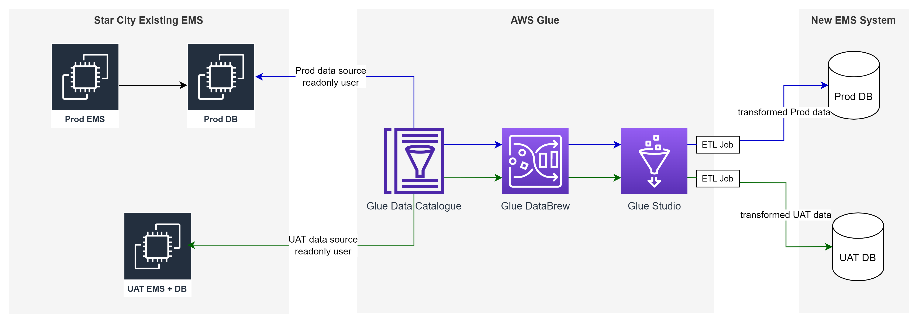
Solution Concept

Slide 68
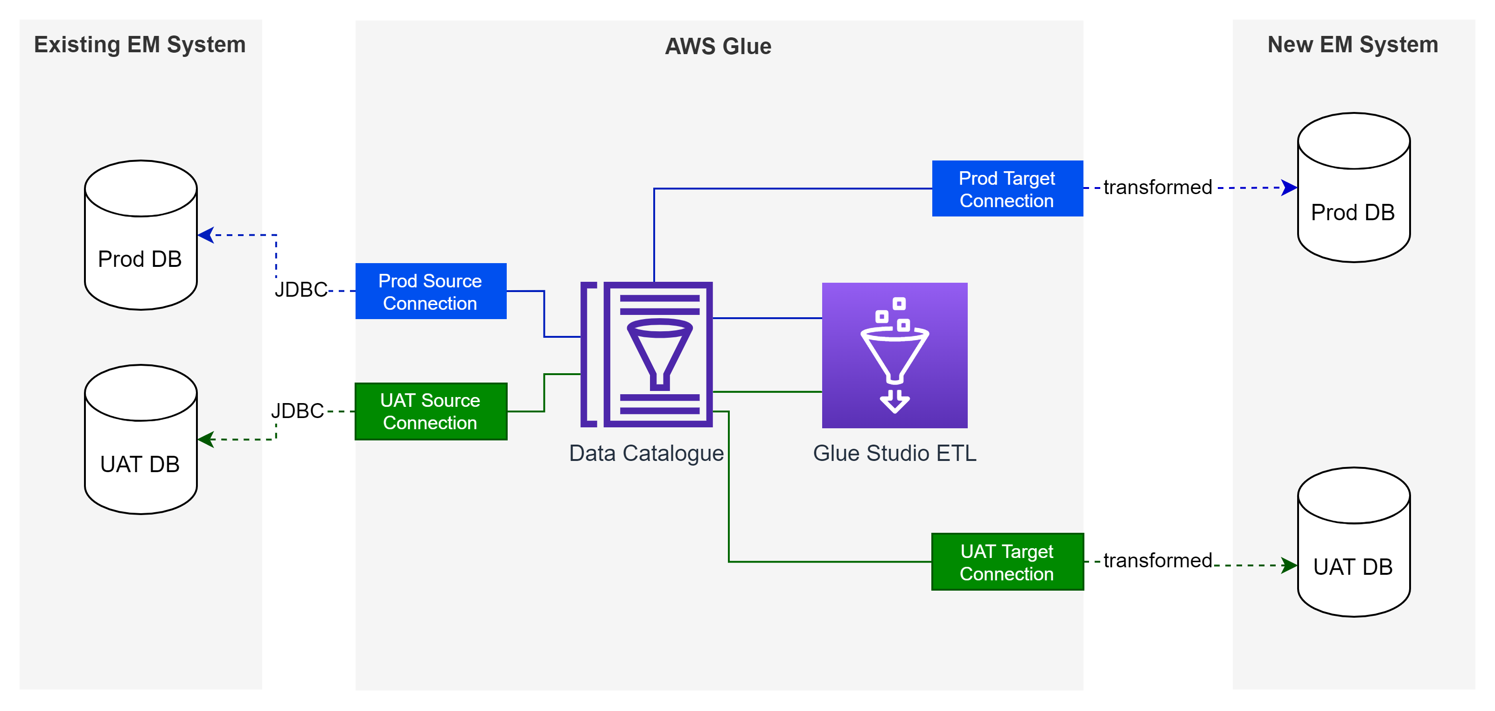
Solution Experiment

Slide 69
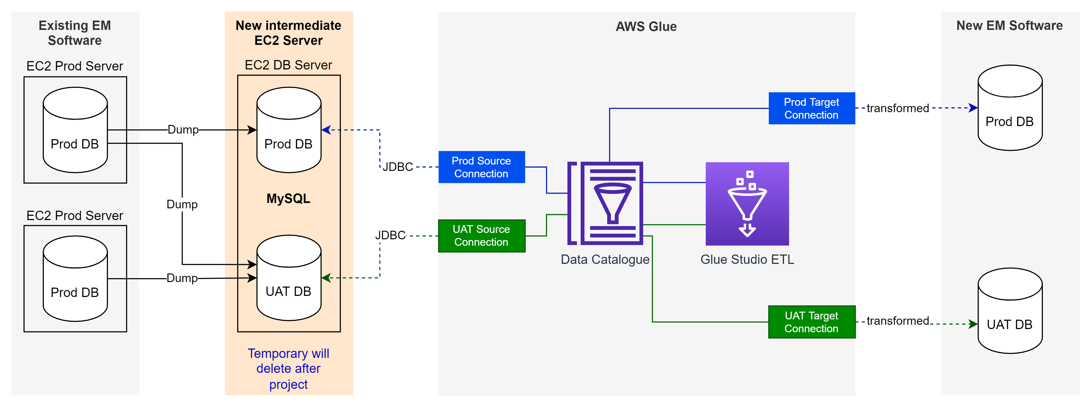
Solution POC

Slide 70
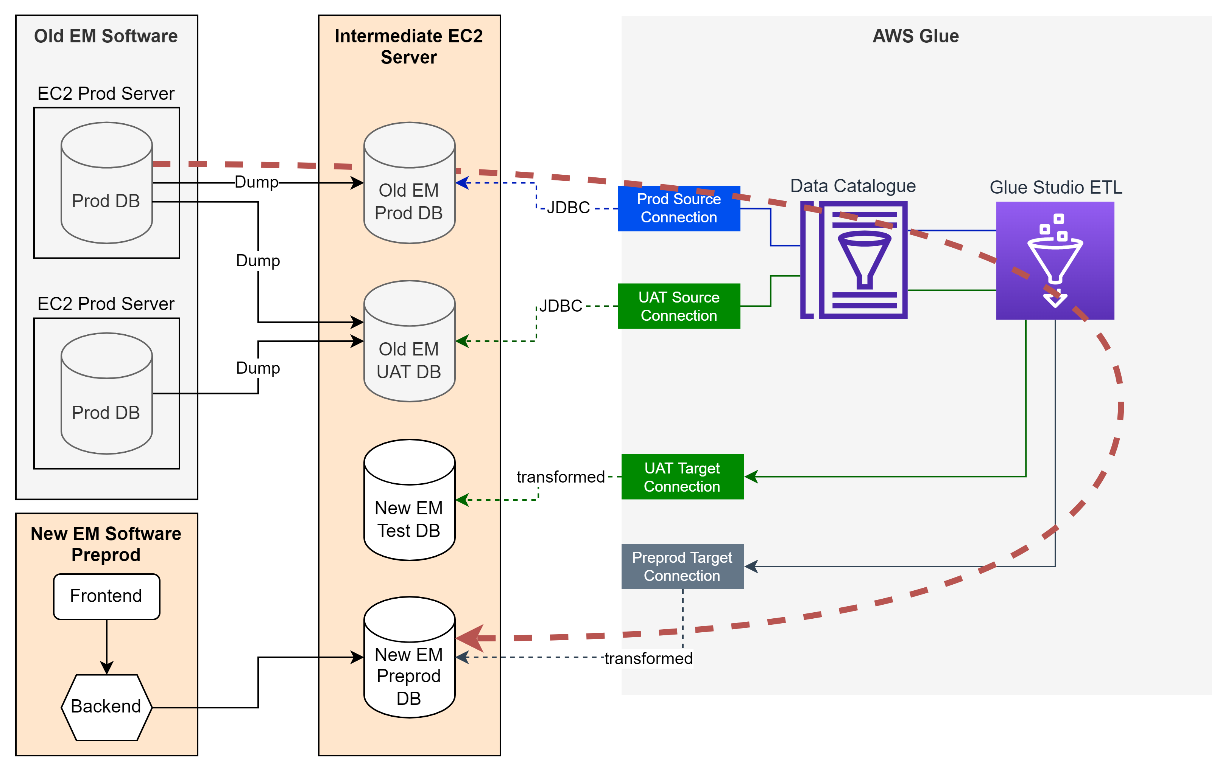
Solution Implementation

Slide 71
Business-Technology Gap
Challenge
Business goals may not align with technological capabilities, leading to unrealistic expectations or underutilization of Technology.
Solution
Solution architects translate business needs into actionable technology plans, ensuring that Technology delivers value to the business.

Slide 72
Data-Application Gap
Challenge
Applications may not have consistent access to high-quality data, resulting in poor functionality or performance.
Solution
By designing a robust data architecture that supports application requirements, solution architects provide reliable data access.

Slide 73
Application-Technology Gap
Challenge
The chosen technical infrastructure may not fully support application needs, causing performance issues or higher costs.
Solution
Solution architects ensure that the technology stack aligns with application performance requirements and scalability needs.

Slide 74
Business-Application Gap
Challenge
Applications may not effectively support business processes due to inadequate functionality or poor user experience.
Solution
Solution architects create application architectures that directly reflect business workflows and objectives.

Slide 75
Making Technical Decision
Weighted Scoring – Decision Making Technique based on data

Slide 76
Steps for Using Weighted Scoring
Identify Evaluation Criteria
List all the criteria that are important for the decision. These can include factors like cost, scalability, performance, security, ease of integration, maintainability, and user experience.
Assign Weights to Criteria
Determine the relative importance of each criterion. Assign a weight to each criterion, ensuring that the total weight sums to 100% or 1.0.
Rate Each Option
For each option, rate how well it meets each criterion on a consistent scale (e.g., 1 to 5, where 5 is the best and 1 is the worst).
Calculate Weighted Scores
Multiply the rating of each option by the weight of the corresponding criterion. Sum these values to get the total weighted score for each option.
Compare and Select the Best Option
Compare the total weighted scores of all options. The option with the highest score is typically the best choice, considering the weighted importance of each criterion.

Slide 77
Selecting Video Streaming Service for HEAL
Example Scenario

Slide 78
Step 1: Identify Evaluation Criteria
Criteria
Web JavaScript SDK support
Native Android SDK Support
Native iOS SDK Support
Cost-effectiveness
HIPAA Compliant
Easy Integration
Maintenance-free

Slide 79
Step 2: Assign Weights to Criteria
Criteria | Weight
Web JavaScript SDK support | 20%
Native Android SDK Support | 20%
Native iOS SDK Support | 20%
Cost-effectiveness | 10%
HIPAA Compliant | 5%
Easy Integration | 10%
Maintenance-free | 15%

Slide 80
Step 3: Rate Each Option (1 to 5)
Criteria | daily.co | doxy.me | twilio.com | Infobip.com | antmedia.io
Web JavaScript SDK support | 5 | 5 | 5 | 5 | 5
Native Android SDK Support | 5 | 0 | 5 | 5 | 5
Native iOS SDK Support | 5 | 0 | 5 | 5 | 5
Cost-effectiveness | 3 | 2 | 4 | 1 | 5
HIPAA Compliant | 5 | 5 | 5 | 5 | 1
Easy Integration | 5 | 5 | 5 | 5 | 1
Maintenance-free | 5 | 5 | 5 | 5 | 0

Slide 81
Step 4: Calculate Weighted Scores
Criteria | Weight | daily.co | doxy.me | twilio | Infobip | antmedia
Web JavaScript SDK support | 20% | 5x20%=1 | 5x20%=1 | 5x20%=1 | 5x20%=1 | 5x20%=1
Native Android SDK Support | 20% | 5x20%=1 | 0x20%=0 | 5x20%=1 | 5x20%=1 | 5x20%=1
Native iOS SDK Support | 20% | 5x20%=1 | 0x20%=0 | 5x20%=1 | 5x20%=1 | 5x20%=1
Cost-effectiveness | 10% | 3x10%=0.3 | 2x10%=0.2 | 4x10%=0.4 | 1x10%=0.1 | 5x10%=0.5
HIPAA Compliant | 5% | 5x5%=0.25 | 5x5%=0.25 | 5x5%=0.25 | 5x5%=0.25 | 1x5%=0.05
Easy Integration | 10% | 5x10%=0.5 | 5x10%=0.5 | 5x10%=0.5 | 5x10%=0.5 | 1x10%=0.1
Maintenance-free | 15% | 5x15%=0.75 | 5x15%=0.75 | 5x15%=0.75 | 5x15%=0.75 | 0x15%=0
Total Score = |  | 4.8 | 2.7 | 4.9 | 4.6 | 3.65

Slide 82
Step 5: Compare and Select the Best Option
Option
daily.co | 4.8
doxy.me | 2.7
twilio | 4.9
Infobip | 4.6
antmedia | 3.65
twilio got the highest total weighted score and would be considered the best choice based on the criteria and weights assigned.

Slide 83
Benefits of Weighted Scoring
Objective Decision-Making
Reduces bias by using quantifiable data.
Transparency
Makes it clear why a particular option was chosen.
Flexibility
Can adjust weights and criteria as needed to reflect changing priorities.
Stakeholder Buy-In
Facilitates discussions and consensus among stakeholders.

Slide 84
Data Modeling
Creating a visual representation of a system's data and its relationships

Slide 85
Key Concepts
Entity
a real-world object
Attribute
property or characteristic of an entity
Relationship
how entities interact with each other
Primary Key (PK)
unique identifier for an entity
Foreign Key (FK)
creates a relationship between two tables

Slide 86
Three Modeling Levels
Conceptual
Purpose: High-level view of system. Focuses on identifying and relationships.
Components: Entities and Relationships
Logical
Purpose: Adds more detail to the conceptual model. Define attributes, primary keys and foreign keys
Components: Entities, attributes, primary keys, foreign keys and relationships.
Physical
Purpose: Actual Implementation
Components: Tables, columns, data types, primary keys, foreign keys, indexes, constraints.

Slide 87
Implementation and Tools
Conceptual Modeling (Diagram)
https://app.diagrams.net
E.g.: Job Portal Conceptual Model
Logical Modeling (DBML)
https://dbdiagram.io
E.g.: Job Portal DBML Script
Physical Modeling
https://dbdiagram.io
Laravel Migrations & Seeding

Slide 88
API Fundamental
Basics of Application Programming Interface

Slide 89
Types of API
REST (Representational State Transfer)
Uses standard HTTP methods with multiple endpoints, focuses on resources and stateless communication.
GraphQL
Single endpoint with flexible queries, strong typing, and real-time capabilities.
SOAP (Simple Object Access Protocol)
Protocol using XML for structured information exchange with built-in security and error handling.
RPC (Remote Procedure Call)
Executes remote procedures using XML or JSON, simple to implement.
gRPC
High-performance framework using Protocol Buffers, supports multiple languages and bi-directional streaming

Slide 90
Open API Specification
API Definition

Slide 91
Basis
A specification for building APIs.
It offers a standardized way to describe RESTful APIs.
Current version 3.x.x
Defined using YAML or JSON
Describes endpoints, methods, parameters, request bodies, responses, and authentication.

Slide 92
Composition
openapi: 3.1.0
info:
tags:
paths:
components:
schemas:
examples:
responses:
securitySchemes:

Slide 93
Tools & Example
Swagger UI
Visualization tool that renders API documentation from an OpenAPI definition.
Swagger Editor
Helps write and validate OpenAPI definitions.
PostMan
Define, Test, Create Documentation, convert postman collection to OpenAPI format
APIGit
UI Designer, Documentation, SaaS platform.
Example:
https://app.swaggerhub.com/apis/aungkyawminn.me/Standard_Backend_API_Definition/1.0.0

Slide 94
API Lifecycle
Created
Published
Deprecated
Retired
Blocked

Slide 95
Thanks
End of only beginning. There’s so much to learn out there …
Aung Kyaw Minn

